Slide 1
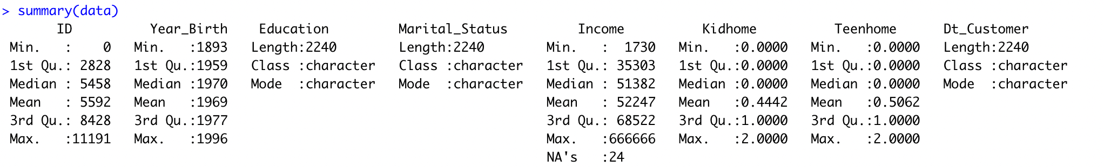
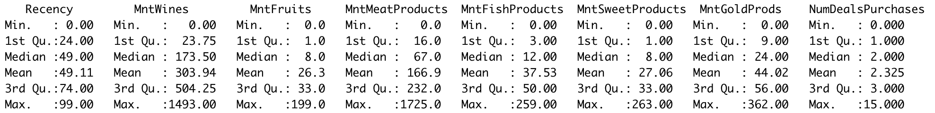
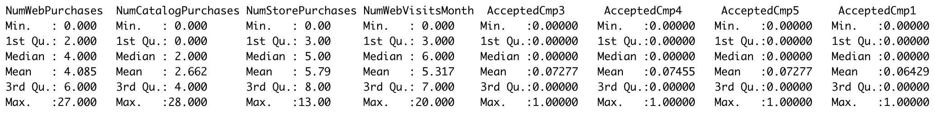
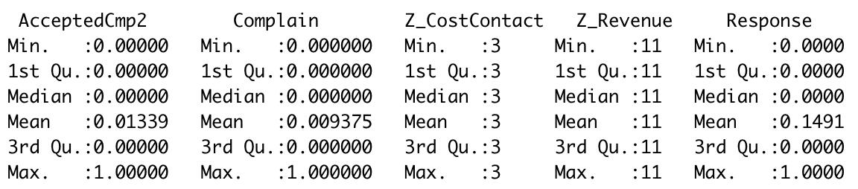
Summary of Data

Slide 2
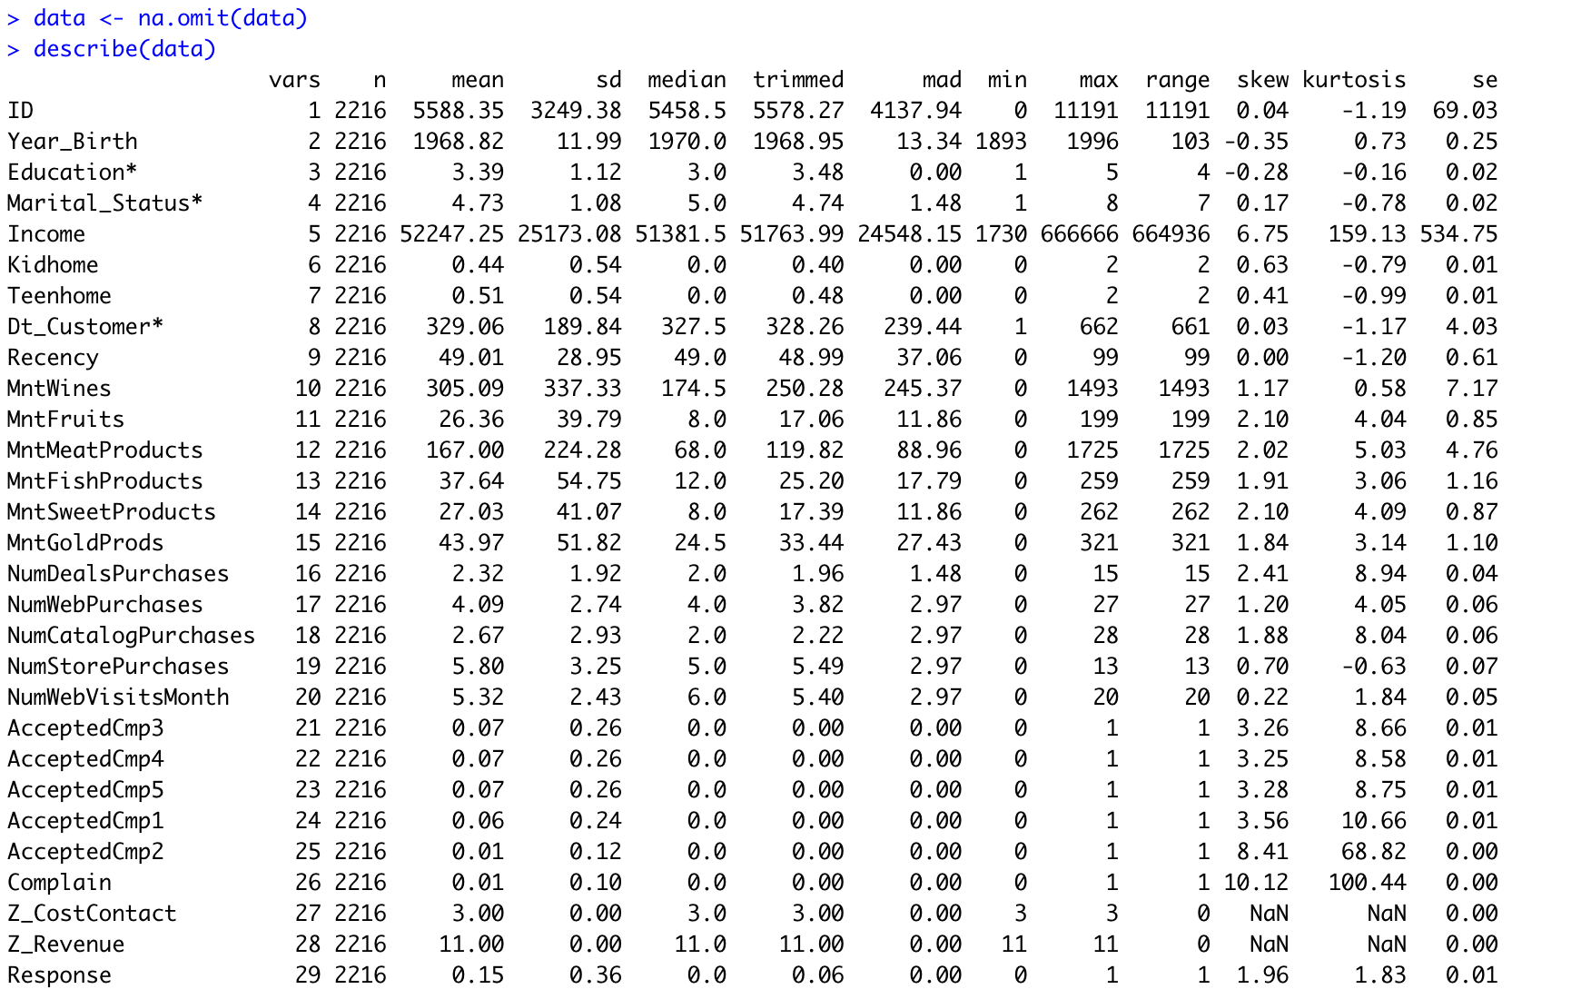
Data Clean & Description of Data

Slide 3
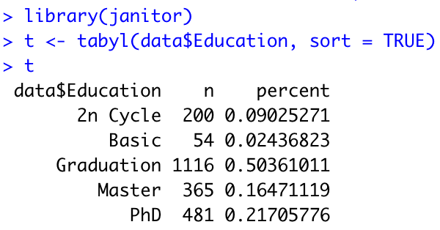
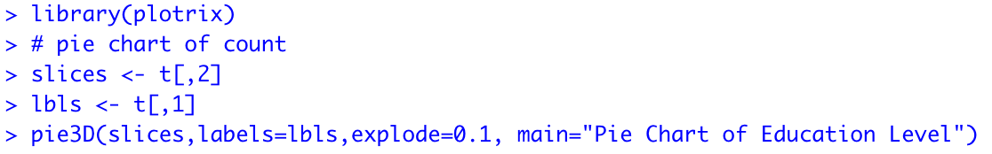
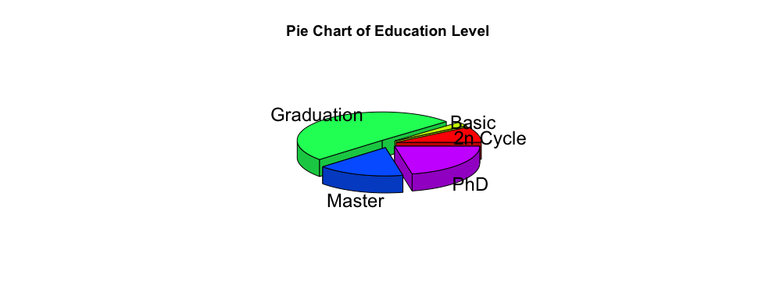
Descriptive Table of Education levels & graphs

Slide 4
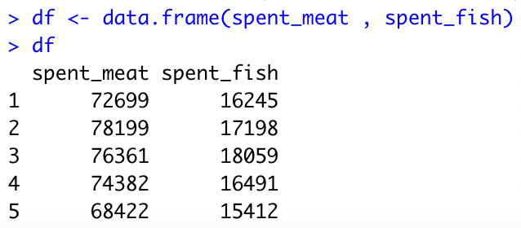
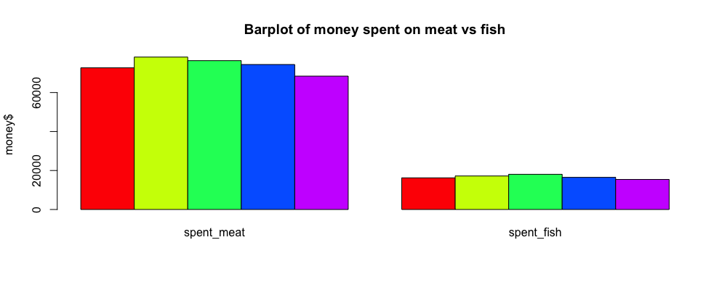
Business Question: What is the comparison for customers with different education levels spending money on meat products vs meat products ?

Slide 5
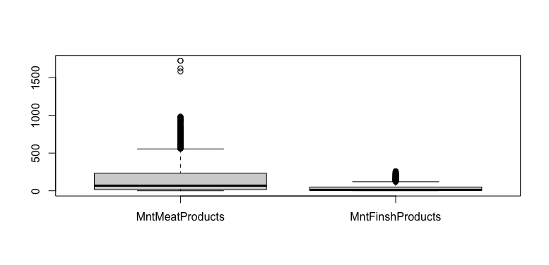
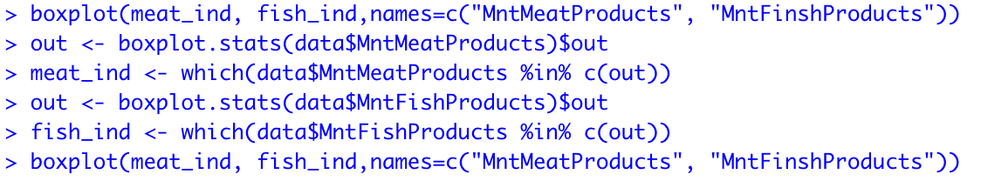
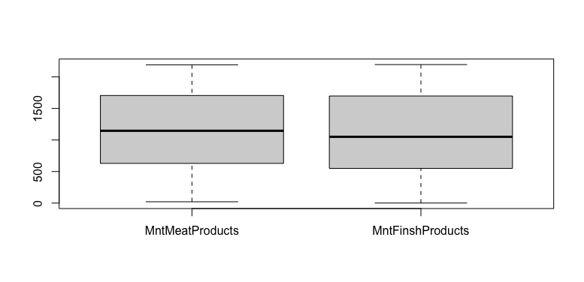
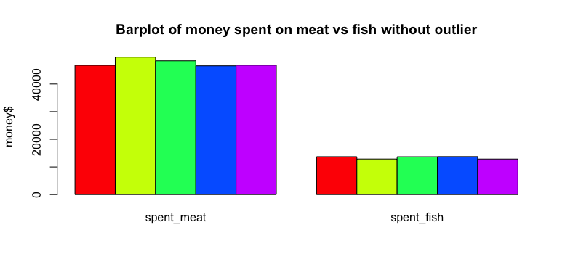
Detect unusual values
Remove the outliers

Slide 6
Additional Questions
1. What is the comparison for customers with different education levels spending money on different products?
Need: MntWines, MntFruits,MntSweetProduct, MntgoldProds
2. Which shopping methods do people prefer, In-store or on-website?
Need: NumStorePurchases, NumWebPurchases, NumWebVistisMonth

Slide 7
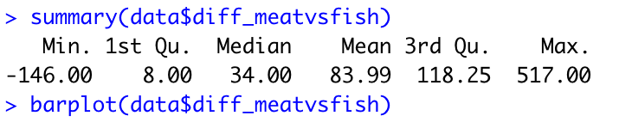
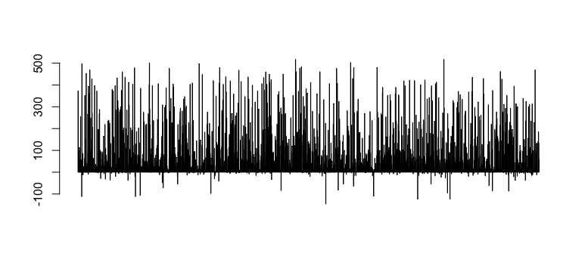
New variable: Difference between money spent on meat vs fish

Slide 8
Conclusion and follow-up questions
1. Most of the customers have graduation
2. Customers spent more money on meat products than fish products
3. Statistically, customers with basic education level spent the most money on meat products. And customers who have graduation education level spent the most money on fish product.
4. Ultimate question: how can we determine the customer personality accurately so that we can promote specific products to meet the need of customers ?

